Slide 1
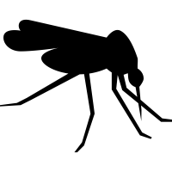
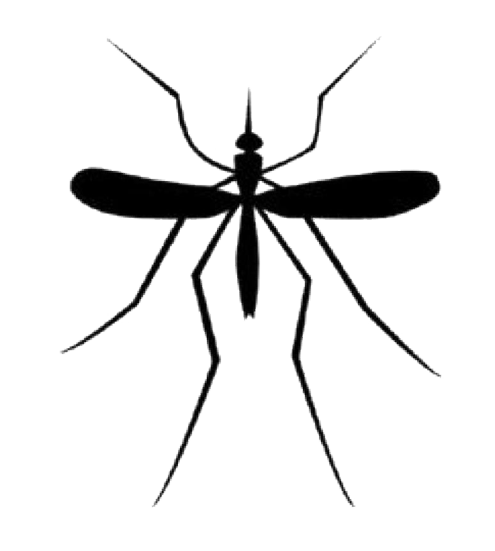
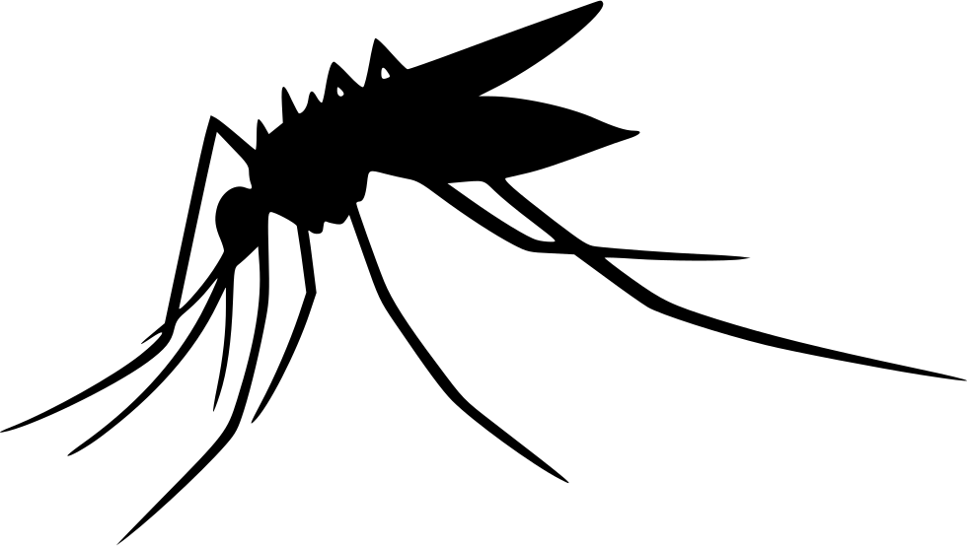
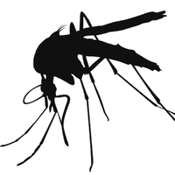
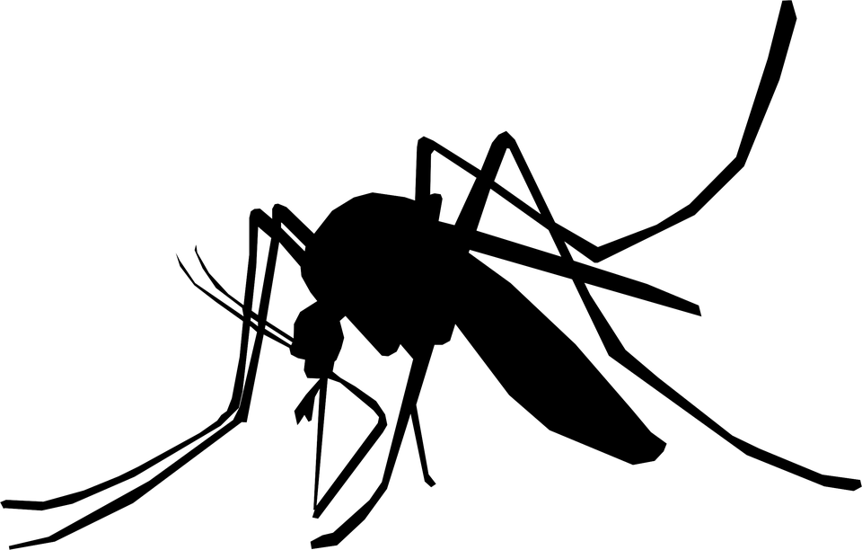
WEST NILE VIRUS
Predicting
In Chicago
William, Mikhail, Chrissy & Claudia

Slide 2
Agenda
Introduction
Problem Statement
Goal
Data Analysis
Feature Extraction
Models
Results
Cost/Benefit Analysis
Conclusion and Recommendations

Slide 3
What is West Nile Virus?
West Nile is a virus most commonly spread to people by mosquito bites. In North America, cases of West Nile virus (WNV) occur during mosquito season, which starts in the summer and continues through fall.
WNV cases have been reported in all of the continental United States.
There are no vaccines to prevent or medications to treat WNV.
About 1 out of 150 infected people develop a serious, sometimes fatal, illness.
Notes:
Chief among these mosquito-borne threats in the United States has been West Nile Virus (WNV). In 1999, WNV’s first reported cases appeared in Queens, NY; by 2001, it was detected in the Chicago area after an increase in bird deaths was linked to the virus. In 2002, Chicago suffered its first, and most severe, WNV epidemic: 225 human cases were reported, including 22 fatalities.

Slide 4
Problem
City of Chicago and the Chicago Department of Public Health (CDPH) had established a comprehensive surveillance and control program.
Every week from late spring through the fall, mosquitos in traps across the city are tested for the virus.
The results of these tests influence when and where the city will spray airborne pesticides to control adult mosquito populations.
A more accurate method of predicting outbreaks of West Nile virus in mosquitos will help the City of Chicago and CPHD more efficiently and effectively allocate resources towards preventing transmission of this potentially deadly virus.

Slide 5
Goals
We need to derive an effective plan to deploy pesticides throughout the city
Build a model to make predictions of when and where different species of mosquitos will test positive for West Nile virus. The city of Chicago can use it when decides where to spray pesticides.
Conduct a cost-benefit analysis. Including annual cost projections for various levels of pesticide coverage (cost) and the effect of these various levels of pesticide coverage (benefit).

Slide 6
Dataset
Weather
Spraying
Train
Test

Slide 7
Data Analysis
Impacts of climatic variables as drivers in the epidemiology of WNV.
Temperature: Increased temperatures cause an upsurge but in some cases, extremely high temperatures begin to slow down mosquito activity
Precipitation: Drought conditions
Humidity: the role of relative humidity in WNV eruptions is very limited
Wind: wind patterns might contribute to virus spread by their impact on wind-blown mosquitoes

Slide 8
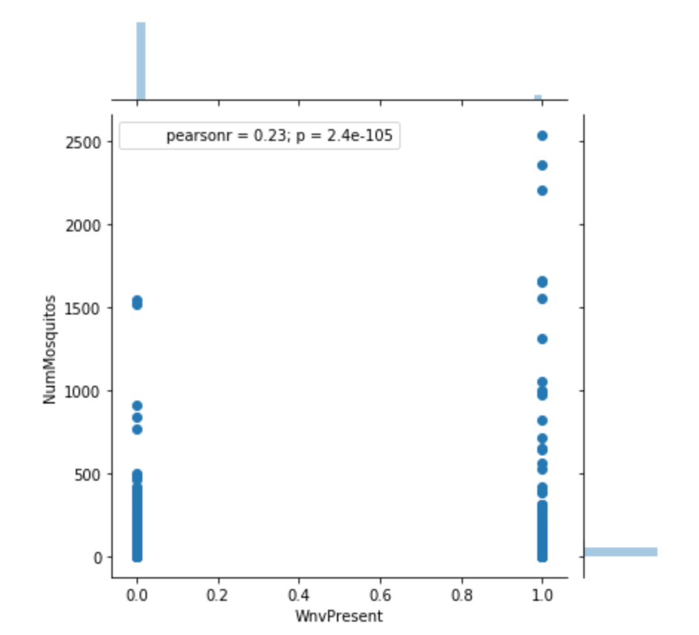
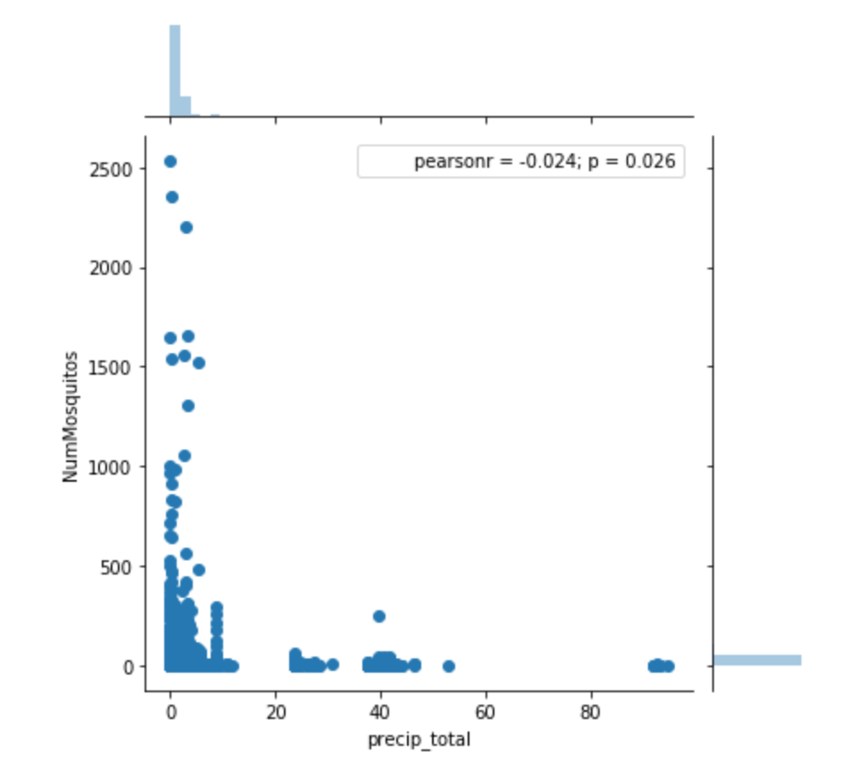
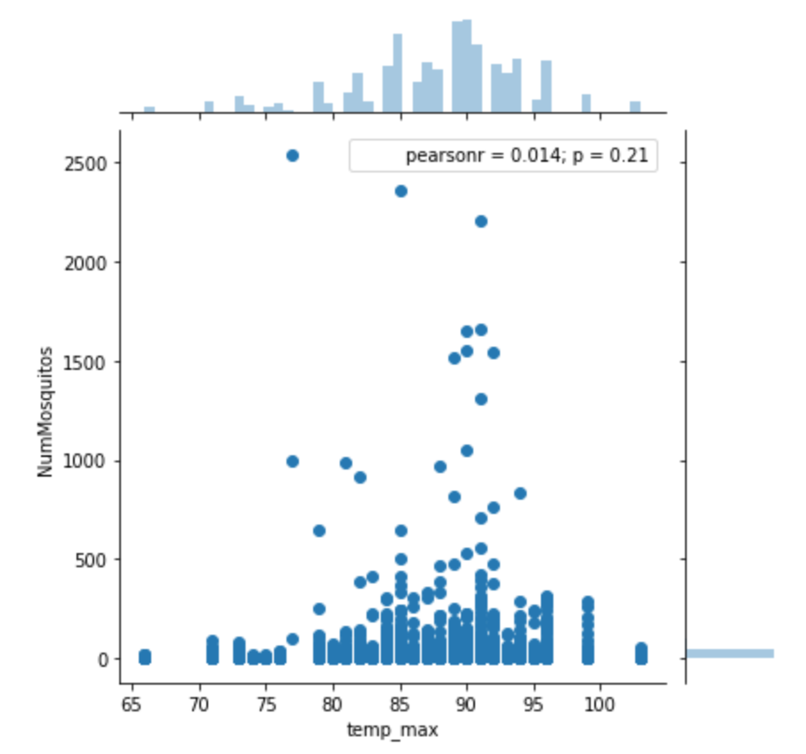
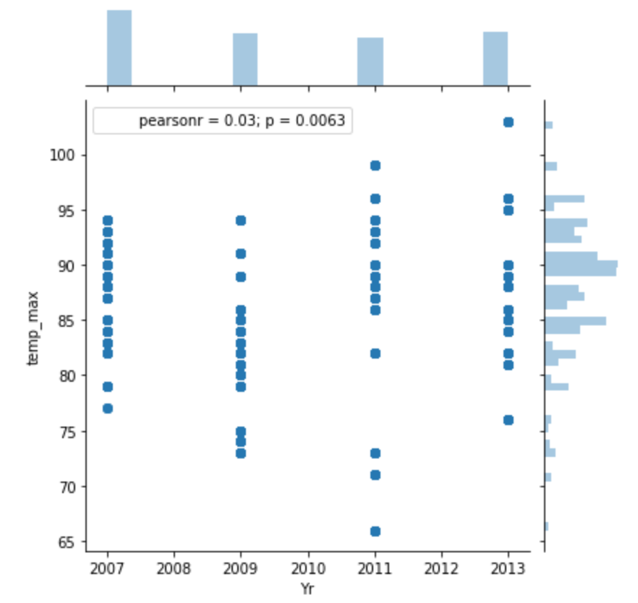

Slide 9
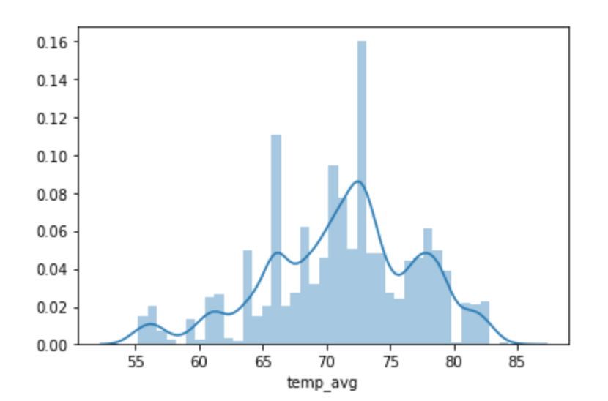

Slide 10
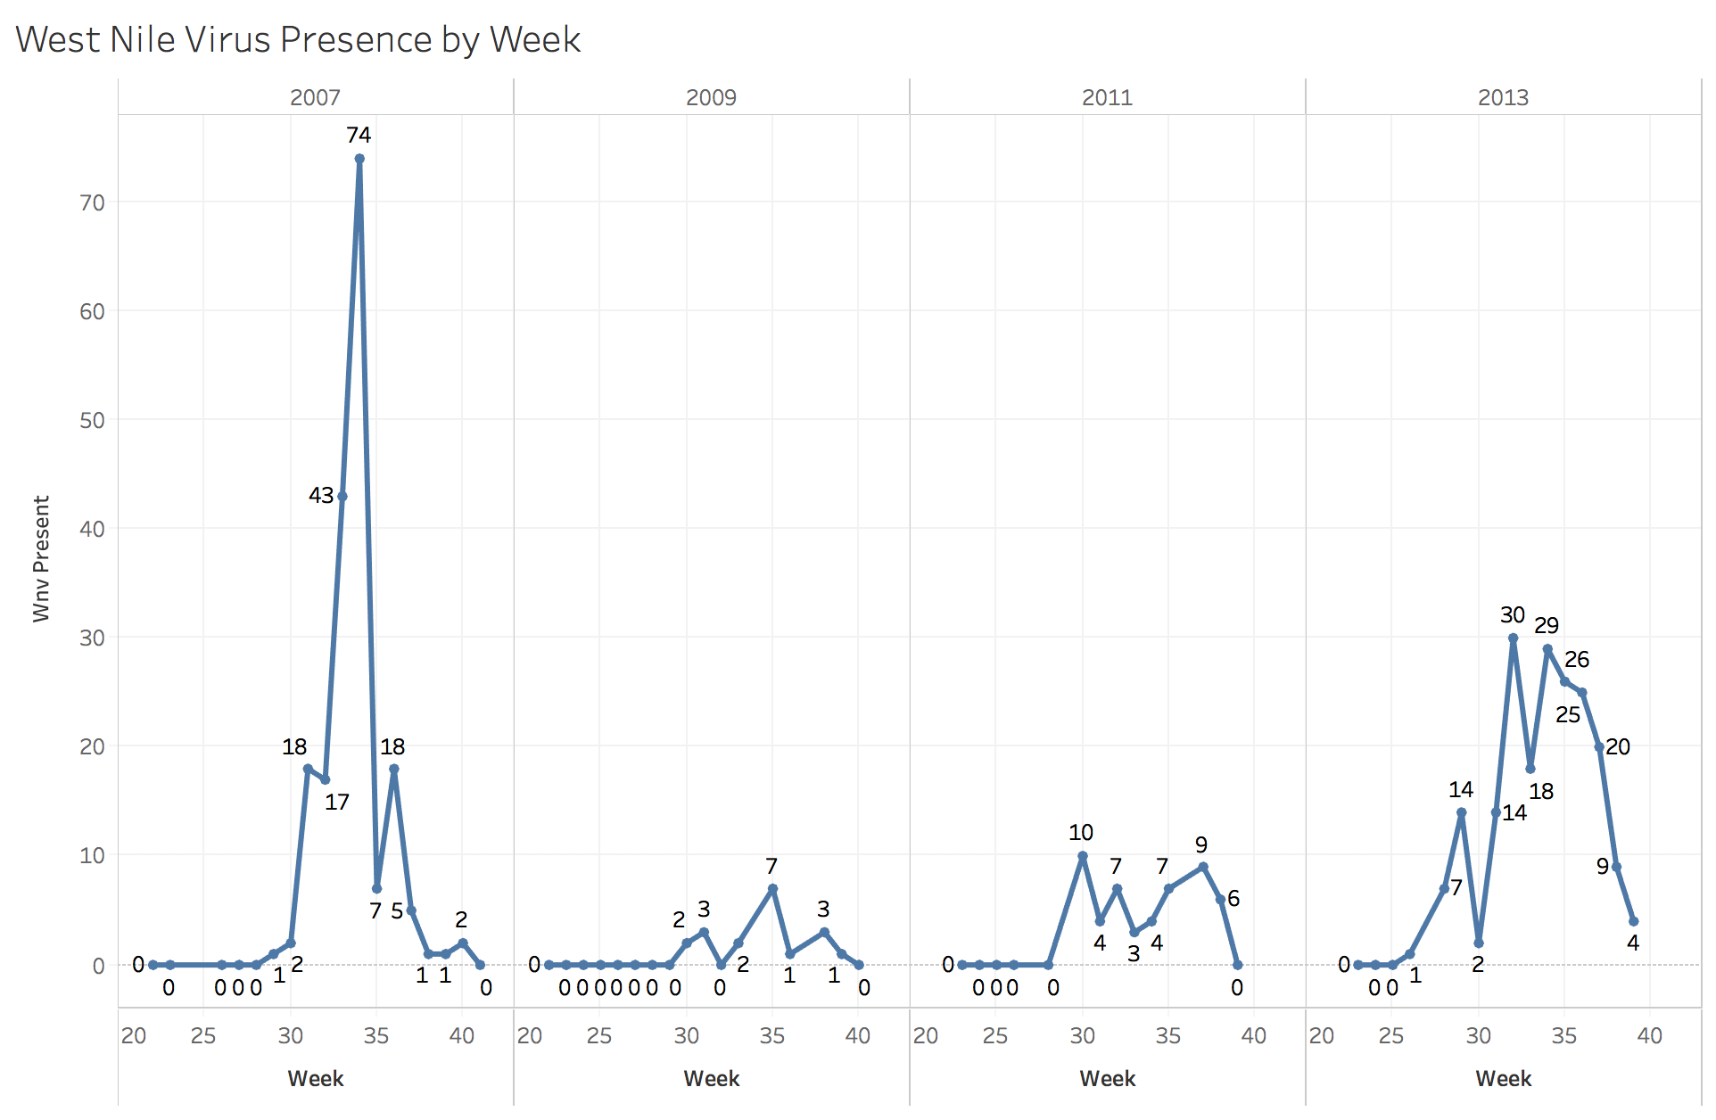

Slide 11
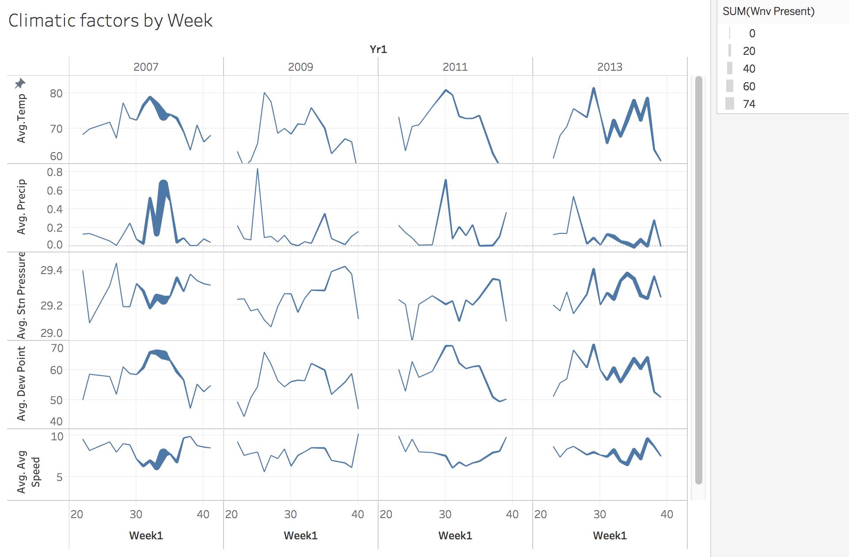

Slide 12
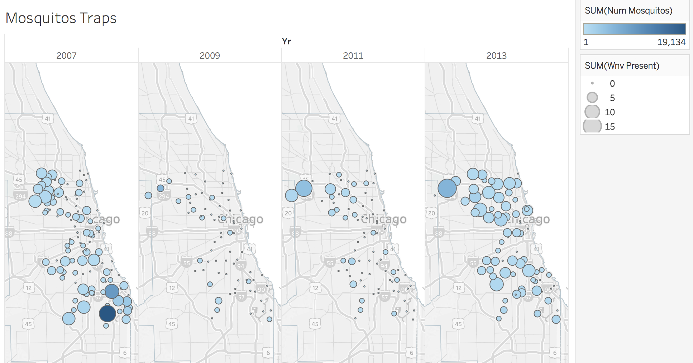

Slide 13
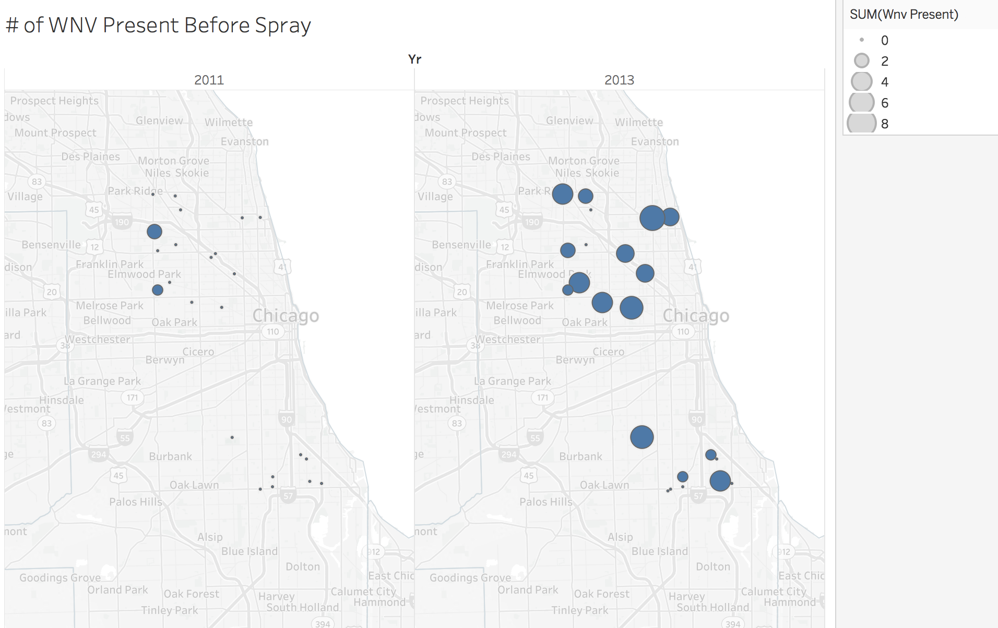
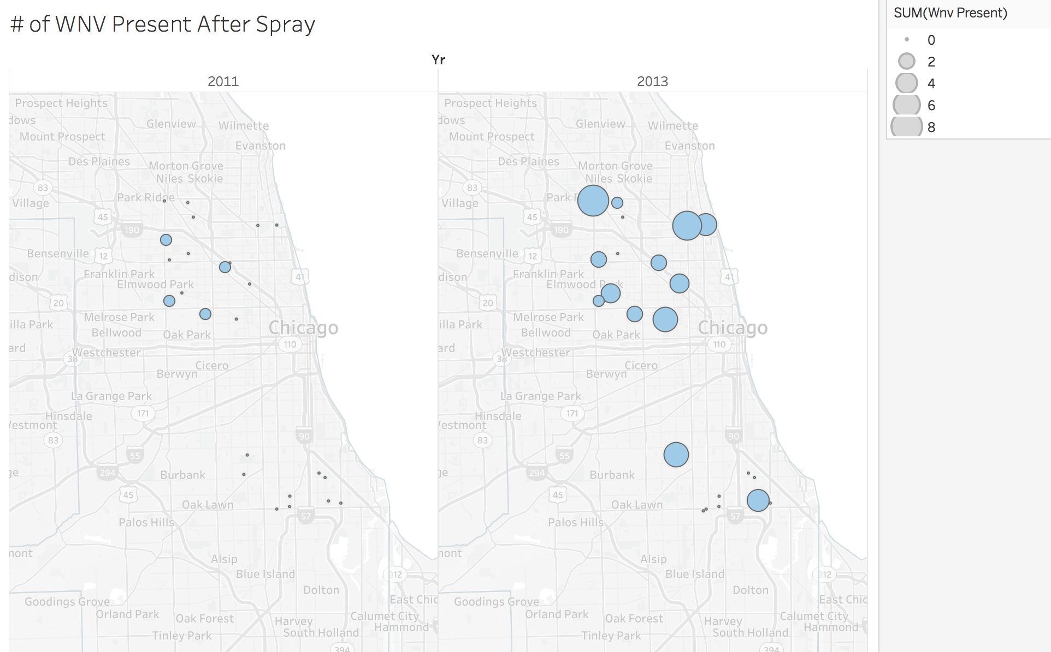

Slide 14
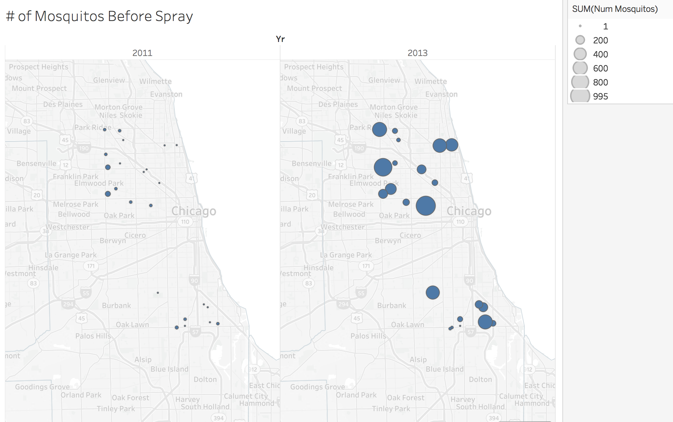
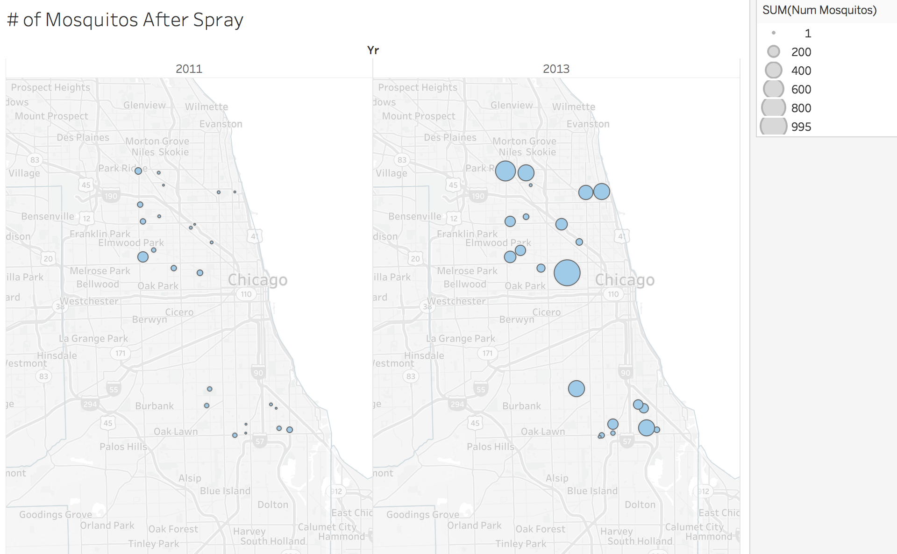

Slide 15
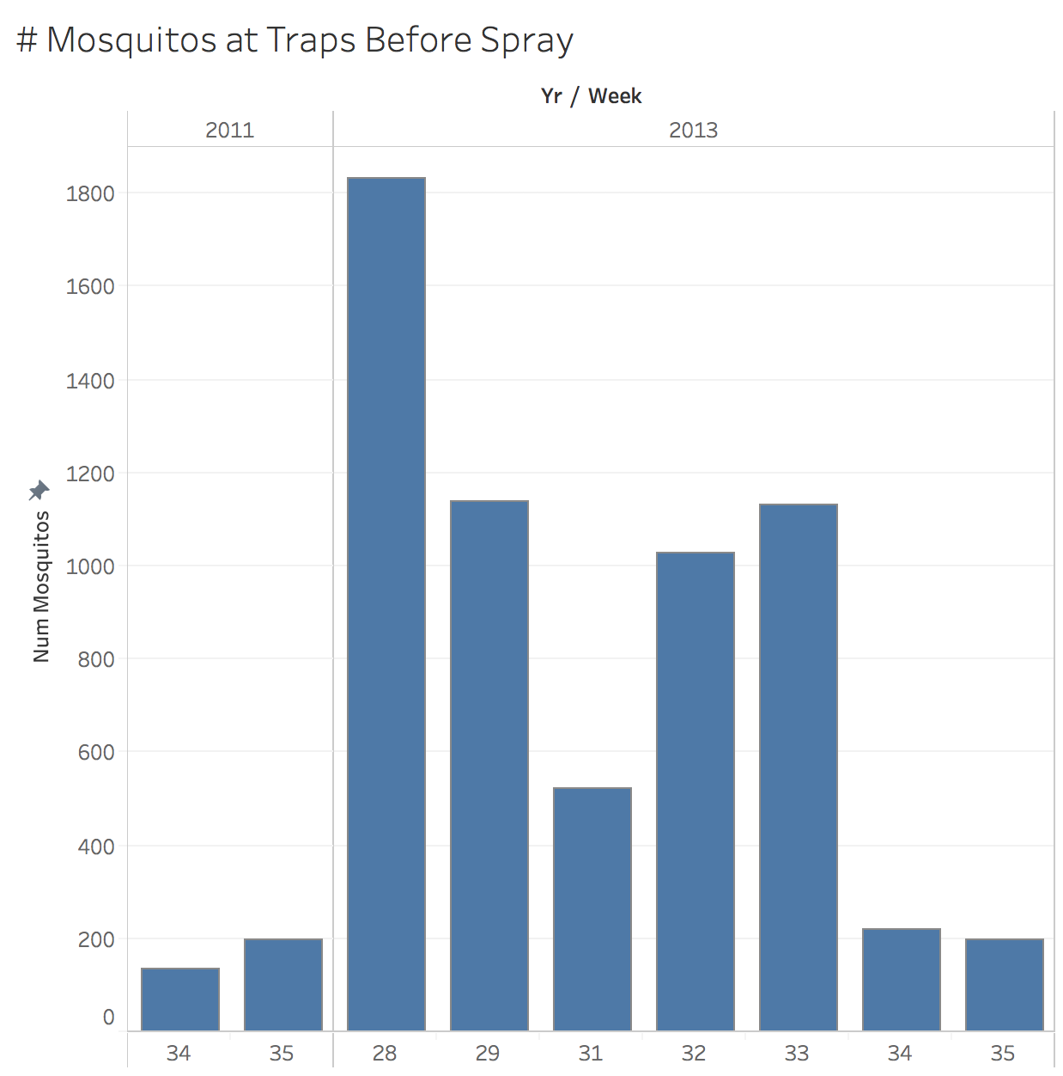
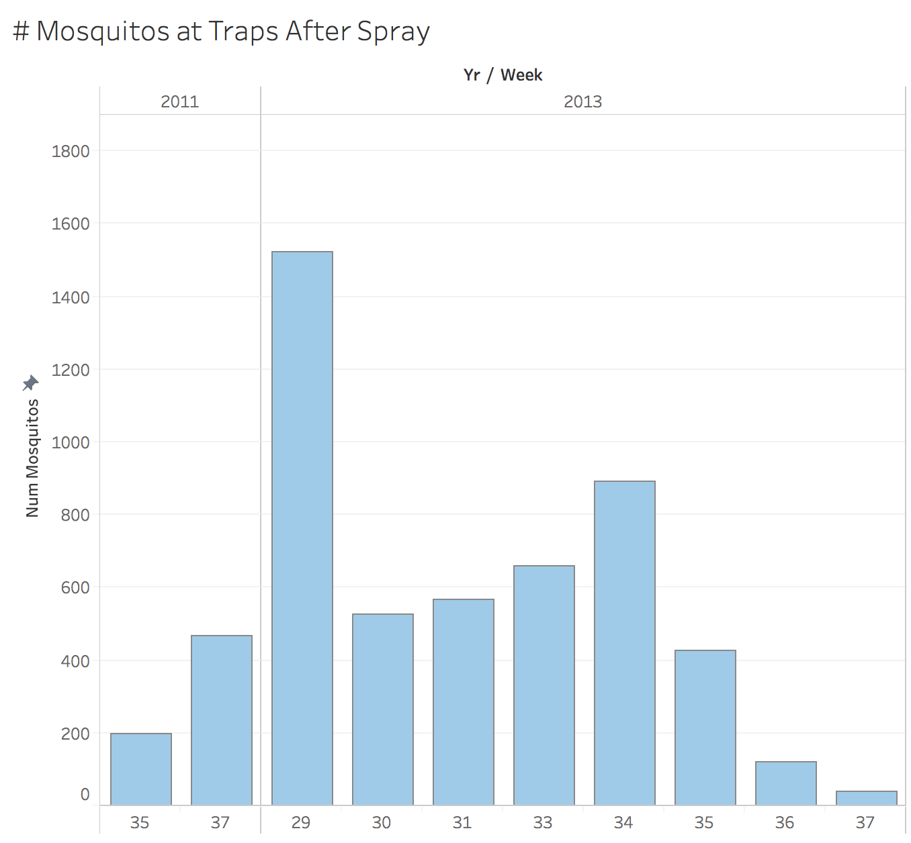

Slide 16
Feature Extraction
What can be measured?
Aggregate weather for each week
Distributions of temp, humidity, precip
Park and water features
Distance (nearest point)
Area (parks – inverse square law)
SVD – PCA?
Time
Week as ordinal, and interval, by not ratio
Proxy: time of sunset, and average (modeled) weekly temperature
Dummy variable for each species (test includes unspecified – base case)

Slide 17
Models
GradientBoostingClassifier
RandomForestClassifier
BaggingClassifier
AdaBoostClassifier

Slide 18
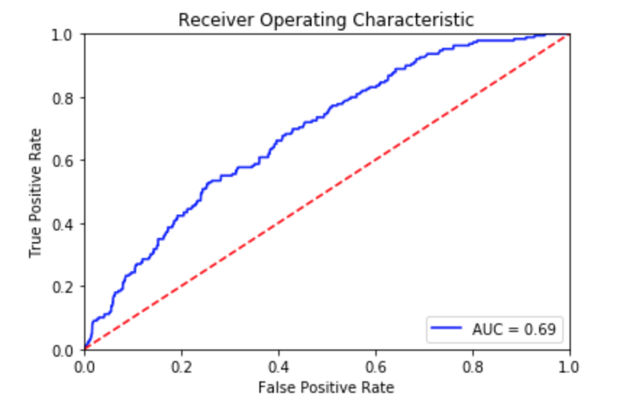
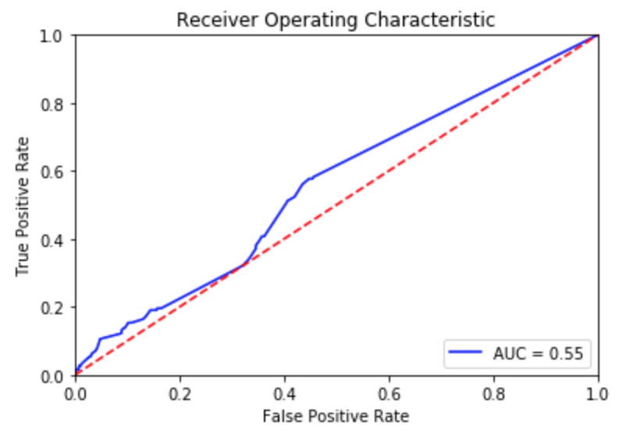
Results
Gradient Boosting Classifier
Random Forest Classifier

Slide 19
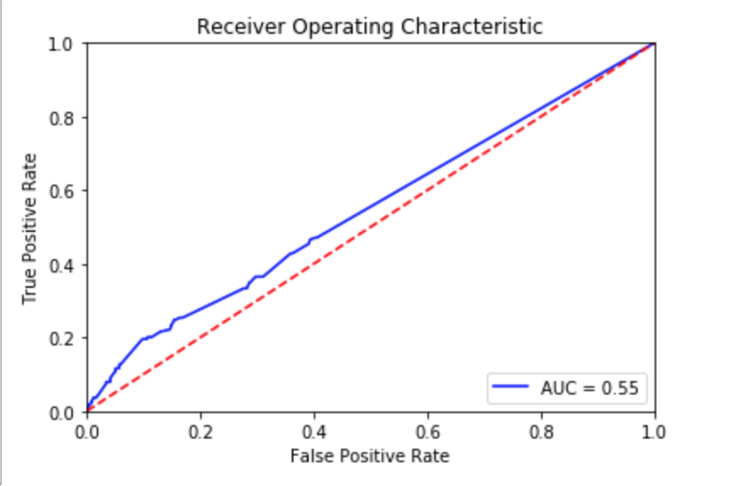
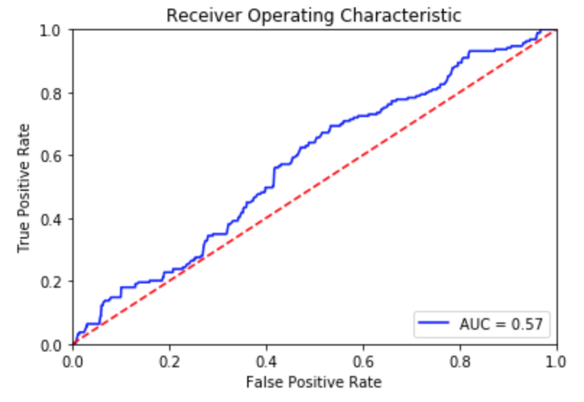
Results
Bagging Classifier
Ada Boost Classifier

Slide 20
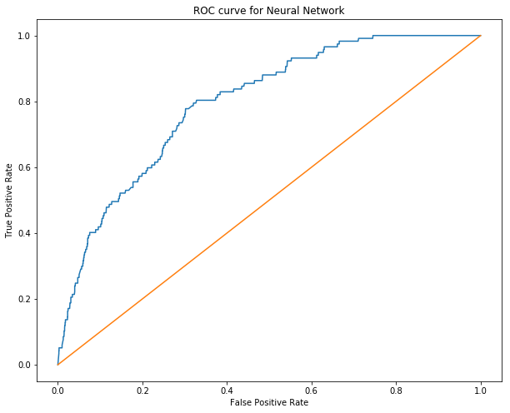
Results: CNN
Dense 128
Dropout .2
Dense 64
Dropout .5
Dense 32
Dropout .3
Dense – output - softmax

Slide 21
Cost/Benefit Analysis
SPRAY
NOT SPRAY
$660K – $6.6M
Vector control cost
was estimated as ≈
$701,790.
Only 32 cases of WNV neuroinvasive disease would need to be prevented to make the emergency spray cost-effective
2012 in IL 290 cases
Total economic costs in 2012 USD for patients with West Nile virus disease by clinical syndrome
Condition | Total long-term Cost $ Median (range) per patient
Fever | $2,271 (0–41,401)
Meningitis | $10,556 (0–260,748)
Encephalitis | $8,055 (0–23,693)
AFP (Acute Flaccid Paralysis) | $22,628 (624–439,945)
Notes:
https://www.ncbi.nlm.nih.gov/pmc/articles/PMC3945683/
http://www.idph.state.il.us/envhealth/wnvsurveillance12.htm
https://www.ncbi.nlm.nih.gov/pmc/articles/PMC4230500/#B92

Slide 22
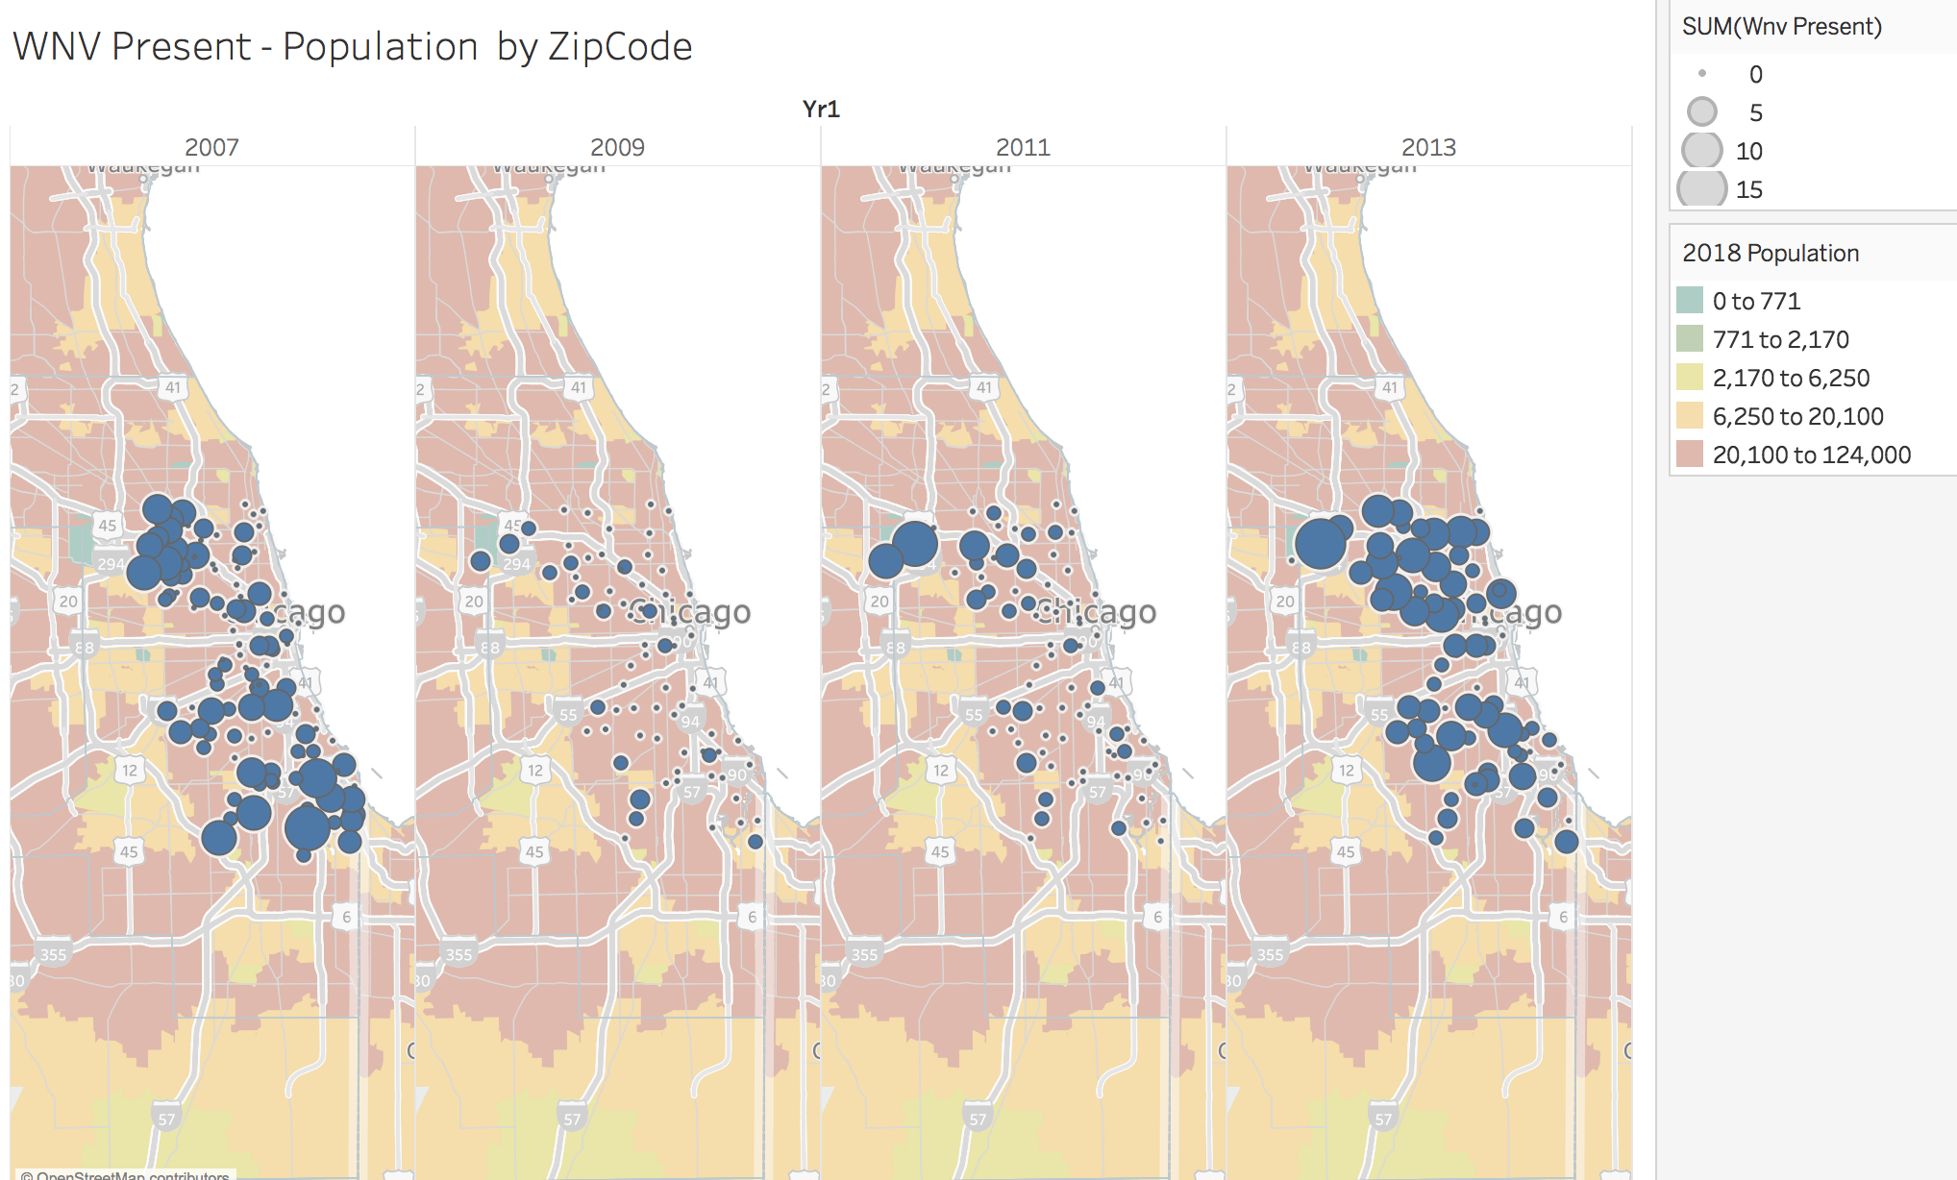

Slide 23
Conclusions and Recommendations

Slide 24
Thank you
Questions?

